Slide 1
Inheritance
These are old slides I created in 2019, in case you want another perspective on inheritance.
RMIT Computer Science and Information Technology

Slide 2
Objects
Objects in a program are built from blueprints
The blueprint is called a class
  more than one object can be built from a given class
class
object

Slide 3
Inheritance
We've seen that classes are a blueprint for providing program functionality in the form of objects.
They are a useful technique for dividing up a program into packets of functionally related data and methods.
This technique of creating entities is a good match for modeling the world, which is full of physical and conceptual objects.

Slide 4
Inheritance
In the real world, we can classify some classes of things as subclasses of other (super) classes.
For example, ‘racing car’ is a subclass of the more generic class 'car', and 'car' itself is a subclass of the even more generic class of ’vehicle’
A subclass inherits characteristics of its superclass
  e.g. assume ‘Vehicle’ has a ‘registrationNum’, so class ‘Car’ will automatically inherit a ‘registrationNum’, and so will the subclass of ‘Car’, ‘Racing car’

Slide 5
Superclasses and subclasses
class Vehicle
registrationNum
class Car
registrationNum
numDoors
superclass of
inherited from Vehicle
class RacingCar
registrationNum
numDoors
racingTeamID
superclass of

Slide 6

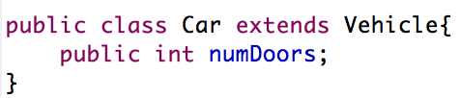
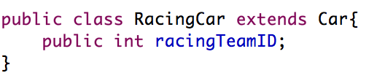
Defining a subclass
The keyword extends is used to define a subclass
superclass of
superclass of

Slide 7
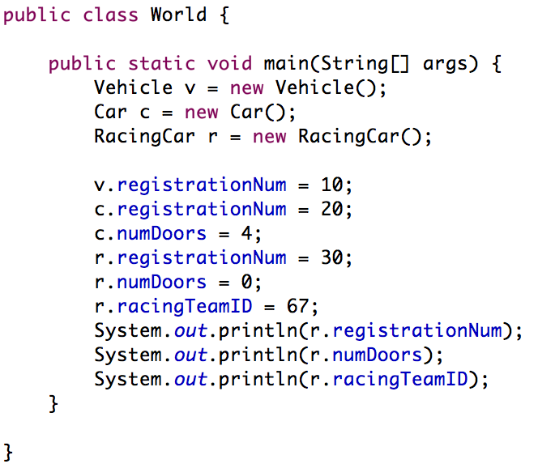
Inheritance
definition inherited
from class Vehicle

Slide 8
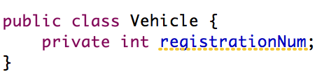
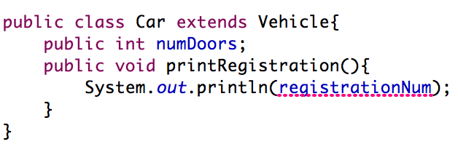
Access modifiers
private instance variables and methods of a superclass aren’t directly accessible by a subclass
Car can’t see registrationNum

Slide 9
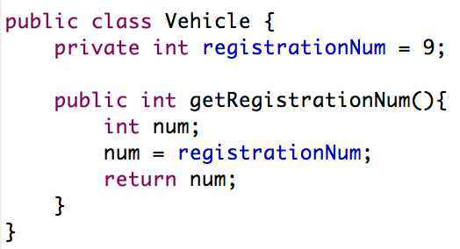
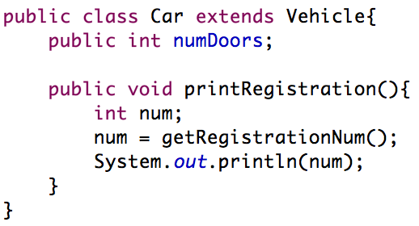
Access modifiers
private instance variables and methods of a superclass are not directly accessible to a subclass
  can still access them indirectly, by calling a superclass public method to access them for us

Slide 10
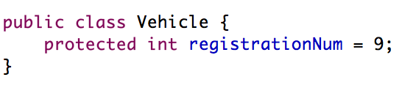
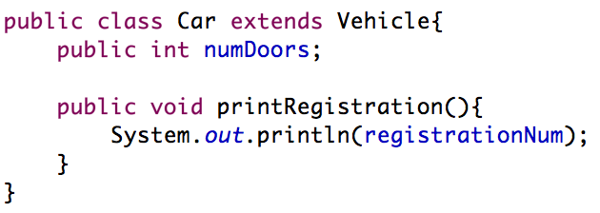
Access modifiers
protected is similar to private, but subclasses can directly access it
  as with private, other classes can’t see it

Slide 11
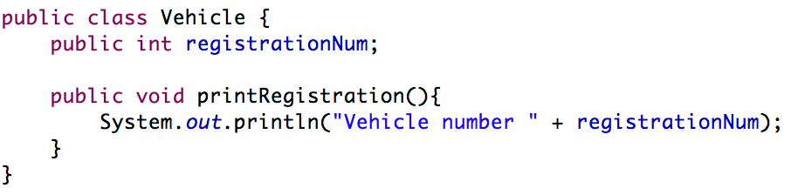
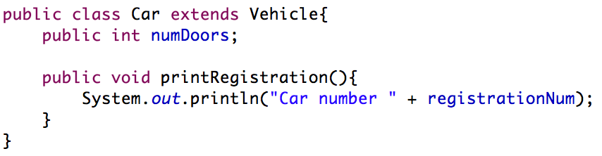
Overriding
A subclass can override a method inherited from a superclass

Slide 12
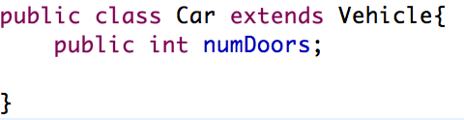
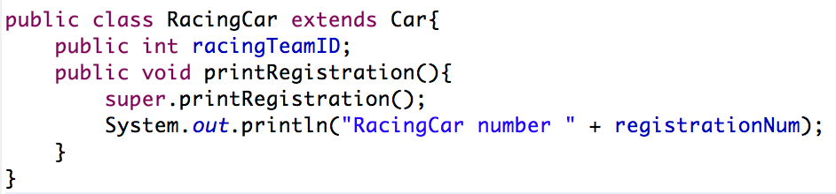
Calling overridden superclass methods
the keyword super can be used to call a superclass method that has been overridden

Slide 13
Calling overridden superclass methods
Car inherits printRegistration from the superclass Vehicle

Slide 14
Calling overridden superclass methods
super.printRegistration() accesses the superclass of RacingCar, which is Car
  Car inherits printRegistration() from class Vehicle

Slide 15
Constructor chaining
We’ve seen how we can write a class constructor, which is run when an object of that class is created
Even if we don’t write a constructor, java provides a ‘do nothing’ one for us
  therefore every class has a constructor, whether we wrote it or not
Constructors are chained – when a RacingCar object is created, it’s (do nothing) constructor is called, which immediately calls the (do nothing) constructor of Car, which immediately calls the (do nothing) constructor of Vehicle
  we can see this by writing a Vehicle constructor that does something...

Slide 16
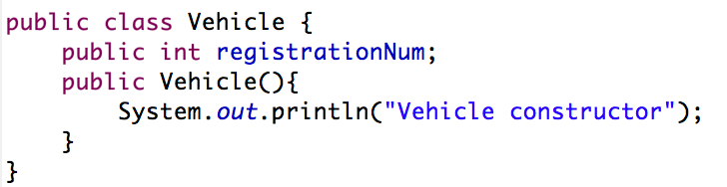
Constructor chaining
Creating a RacingCar object will cause
“Vehicle constructor” to be printed

Slide 17
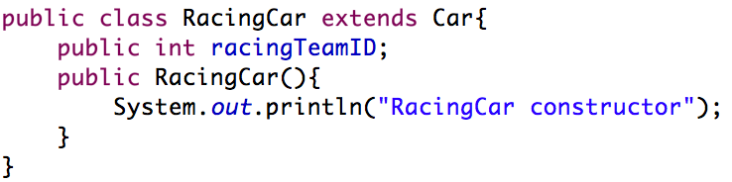
Constructor chaining
Creating a RacingCar object will cause
“Vehicle constructor” and then “RacingCar constructor”
to be printed

Slide 18
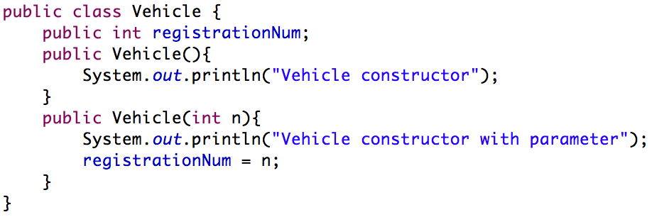
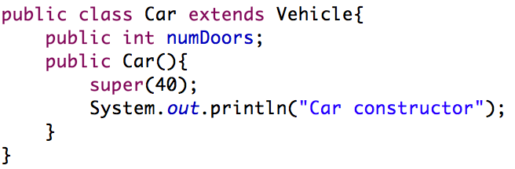
Calling specific constructors
We can use super to call specific superclass constructors

Slide 19
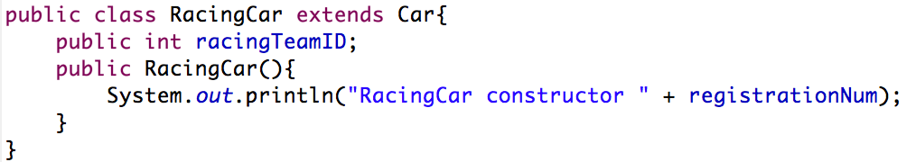
Quiz
What would be written to screen if a RacingCar object was created?

